Slide 1
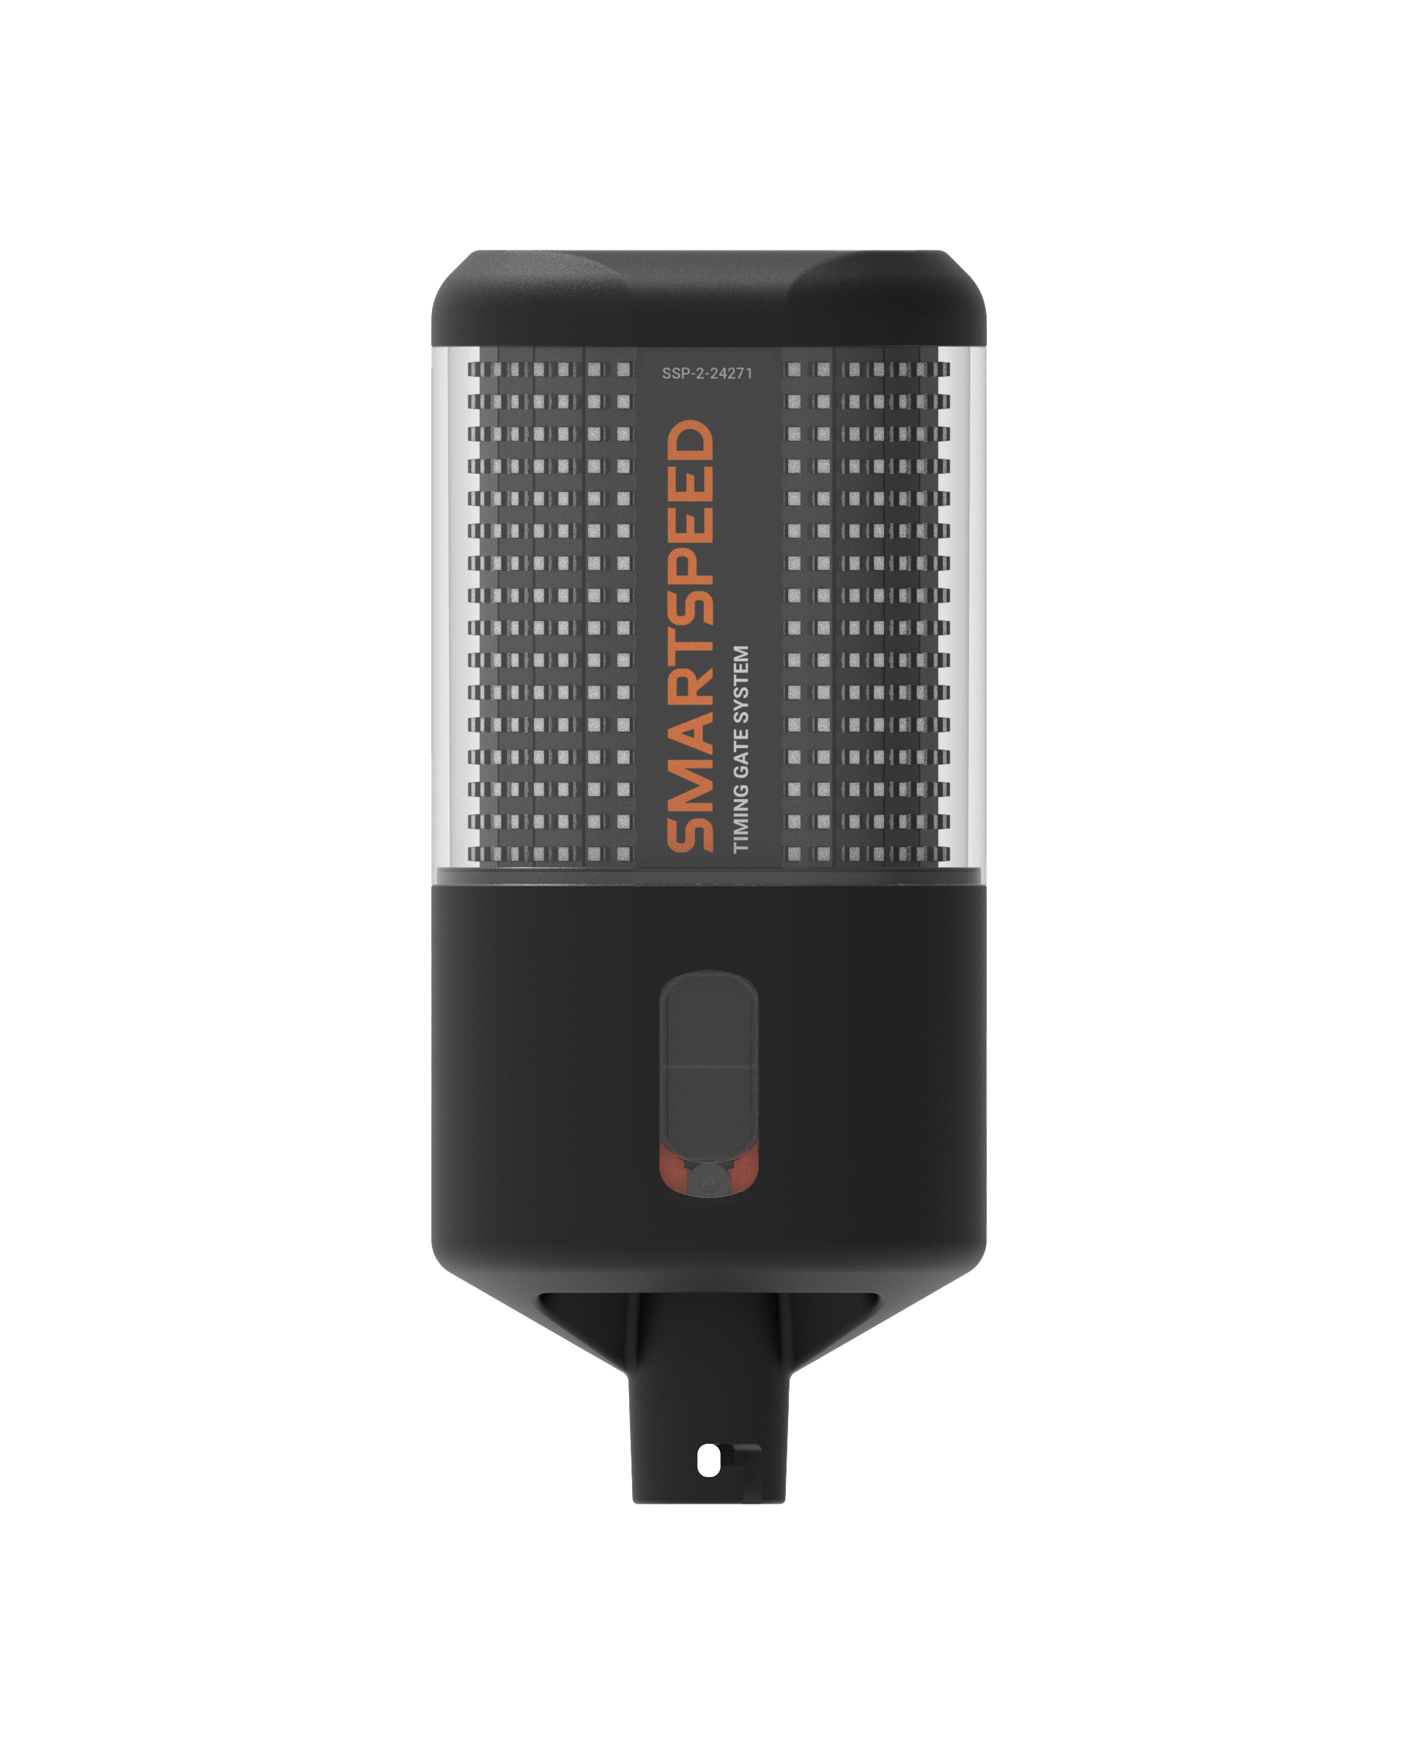
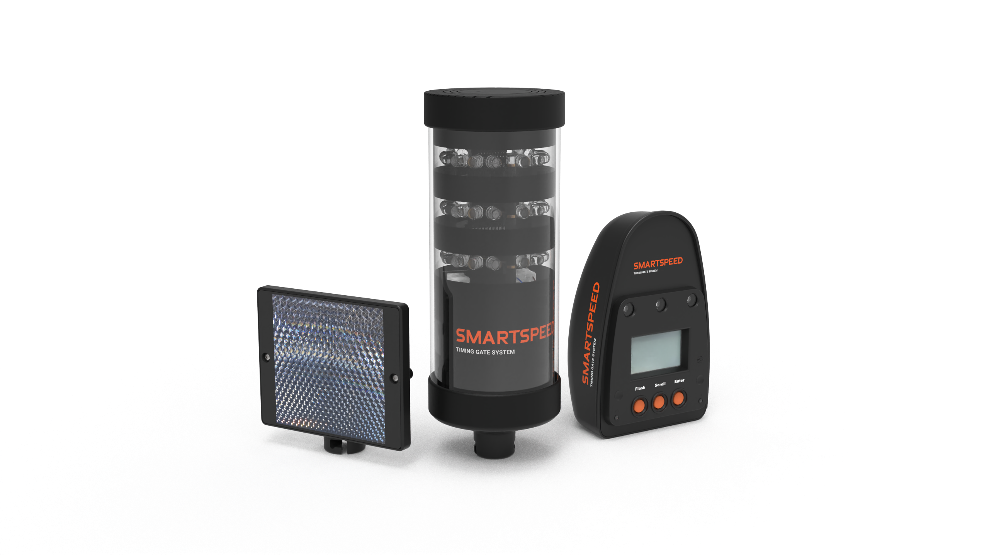
3 m
Left cut
1.5 m
Right cut
6 m
Reaction zone
5 m
1.5m
Acceleration zone
5 m
1.5m

